Slide 1


Slide 2

#LifeKoKaroLift
SGC Coaching:
Session 3
Data Science Tracks

Slide 3
Agenda
Quick Recap –(10 mins)
Focused Discussion –(20 mins)
Career Track Discussion–(60 mins)
Last 2 weeks
EDA Case study Review- Common Doubts
Individual Learning Goals - Career Track Provide Personalized Feedback

Slide 4
Recap: What the learner have learnt in the week
Exploratory Data Analysis
Data Inspection
Analysis variables
Univariate Analysis
Bivariate Analysis
Categorical vs. continuous
Multivariate Analysis
Data Cleaning
Pruning missing values
Outliers treatment
Check logical errors
Filter relevant data
Data Source: Public/private
Data distribution
Checking Columns (Measurement Scale)
Dealing with data size
Visual Analysis
Visual Plotting
Which chart type to use?
Root cause Analysis
Highlighting key insights
Notes:
Measurement scale for columns: Whether they are Nominal, Ordinal, Interval or ratio?
Simple numerical analysis for value distribution

Slide 5
Steps to follow for Exploratory Analysis
Is the data in right shape/ form to answer the business questions?
Is there a bias in the data? Does it capture all key events/ instances?
What is the share of different classes?
(e.g. 40% cancelled)
How do I prioritize entities (e.g. users) as per importance in influencing KPI
(e.g. Credit worthiness)
Which variables show high causation with KPI?
How do different categorical classes vary w.r.t. KPIs?
Bi-variate/ Multi-variate Analysis
Notes:
You can use examples from the dataset and assignment
Learners must lead the conversation.

Slide 6
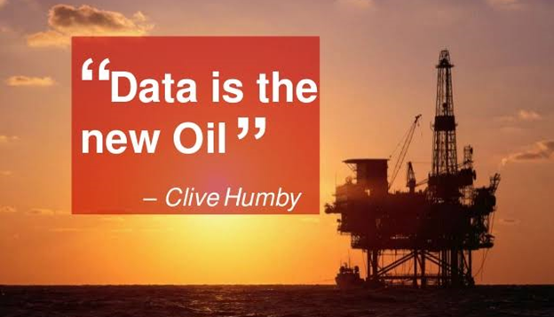
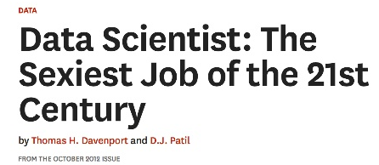
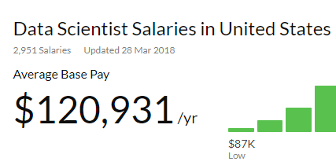

Data Science: Buzz
Notes:
Big data Engineer – Setting data architecture and connect Enterprise ETL tools along with in-computing abilities
Business Analyst- More Business centric Analysis and interpretation of models. Need to know data ETL and modelling as well.
Data Analysis (BI)- Data ETL and working on visual tools along with BI reports
Deep Learner- Computational research and Human AI. Working primarily on Neural networks.
NLP- More sentiment and text analysis, chatbots, and interpreting consumer comments across forums.

Slide 7
Data Science: Definition
Data science is an inter-disciplinary field that uses scientific methods, processes, algorithms and systems to extract knowledge and insights from many structural and unstructured data.

Slide 8
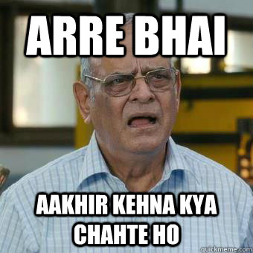
Data Science:

Slide 9
Data Science:
Using data in creative ways to add business value
Discovery of Data
Data Product Development
Business Value

Slide 10
Career Tracks: Path to ML
Individual Contributor
Delegation
Digitalization
Big Data and Analytics
Machine learning
Notes:
Big data Engineer – Setting data architecture and connect Enterprise ETL tools along with in-computing abilities
Business Analyst- More Business centric Analysis and interpretation of models. Need to know data ETL and modelling as well.
Data Analysis (BI)- Data ETL and working on visual tools along with BI reports
Deep Learner- Computational research and Human AI. Working primarily on Neural networks.
NLP- More sentiment and text analysis, chatbots, and interpreting consumer comments across forums.

Slide 11
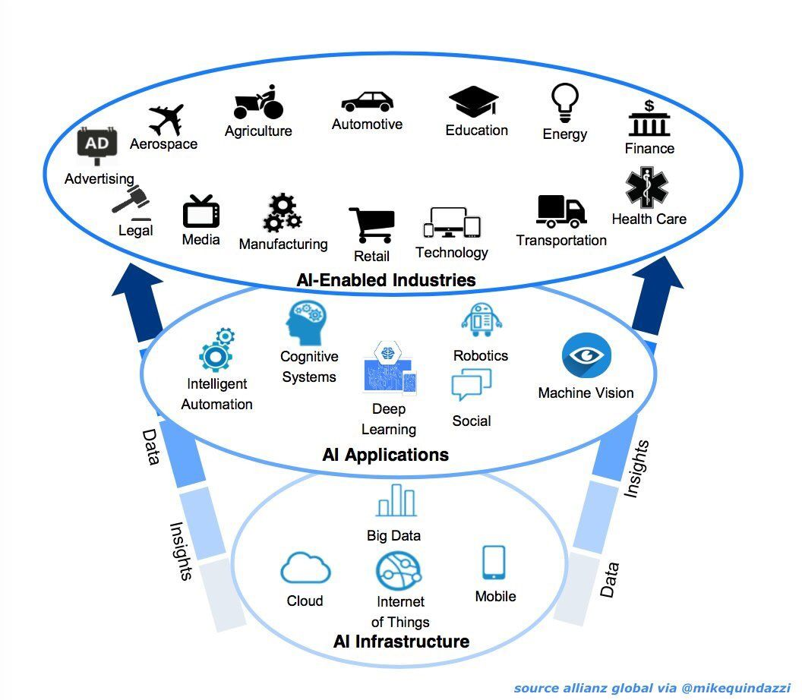
Data Science: Flow
Notes:
Discuss the tools( e.g. Haddop, SQL, Tableau, Python) / techniques(Neural Networks, EDA, Tree models)/ data science solutions (e.g. Assortment optimization, Market basket analysis, MMM) to illustrate the nature of work and skills required.

Slide 12
Data Science:
Data Science in Business
It will monetize data
It will mitigate company risk
Better understanding of their customers.
It will give businesses unique insights
It will help with business expansion
It will improve forecasting.
Provide businesses with objective decisions

Slide 13
Data Science:
Data Science Steps
Frame the problem
Process your data
Explore the data
Communicate the results
Collect the data
Perform in-depth analysis

Slide 14
Focussed Discussion: Solving The case
Solve the Case
Domain
(Check key variables’ causal relationship)
Dispersion
(Balance the data)
Data
(Avoid spurious data)
Notes:
Review the concerns:
Unexpected negative values in data or multiple outliers
Summarize variable values and interdependence using plot
Discuss their analysis and expected steps

Slide 15
Data Science: Skill

Slide 16
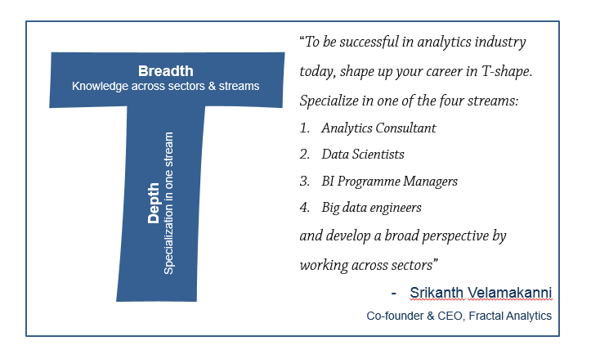
Career Tracks: T shape
Notes:
Big data Engineer – Setting data architecture and connect Enterprise ETL tools along with in-computing abilities
Business Analyst- More Business centric Analysis and interpretation of models. Need to know data ETL and modelling as well.
Data Analysis (BI)- Data ETL and working on visual tools along with BI reports
Deep Learner- Computational research and Human AI. Working primarily on Neural networks.
NLP- More sentiment and text analysis, chatbots, and interpreting consumer comments across forums.

Slide 17
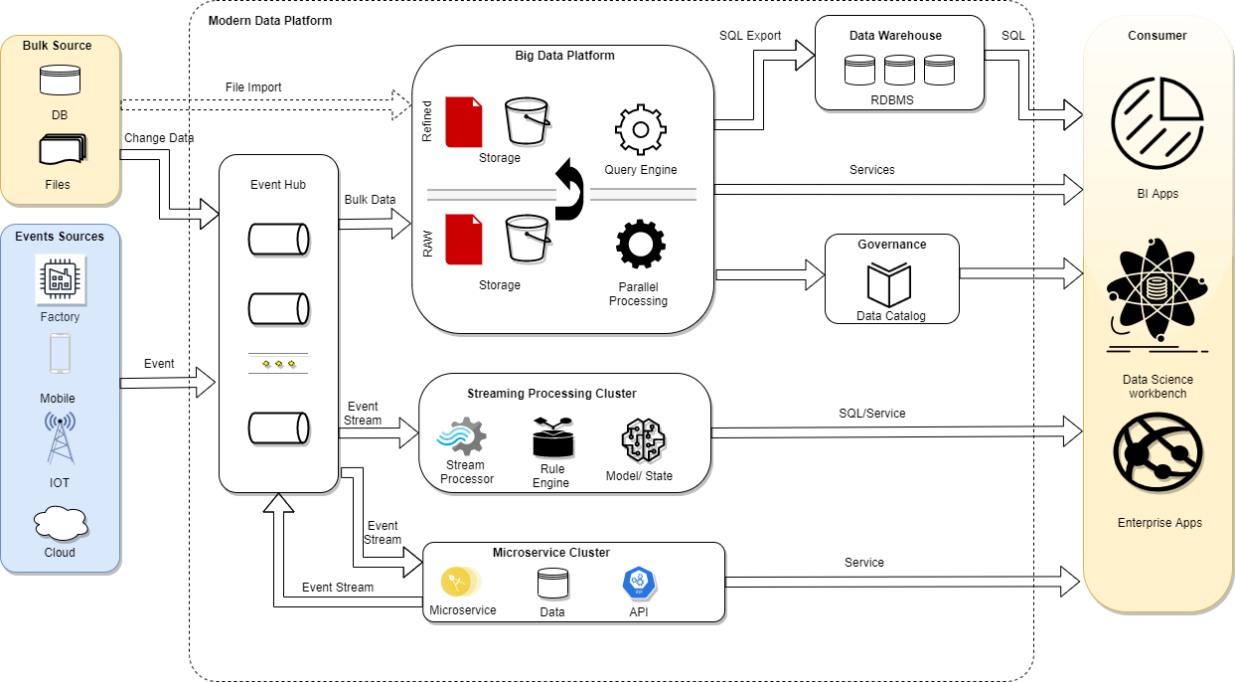
Data Science: Data Flow

Slide 18
What To Focus On For Respective Tracks?
Data Analyst
SQL
Basic statistics
ML / Data Engineer
Algorithms(Basic)
System design / Cloud
Data Scientist
Data Visualization
Research Scientist
Business Analyst
R/Python
Data visualization
Advanced stats
R/Python
Data visualization
ML Algorithm design
Advanced stats
Algorithms (Advance)
ML
Research background
Software Engineer
Reporting
Data cleaning
Data cleaning
Java
Communication
Planning and Monitoring
While each career track has to be proficient with certain tools & techniques, each career track has their own focus areas as mentioned above.
Notes:
Discuss the tools( e.g. Haddop, SQL, Tableau, Python) / techniques(Neural Networks, EDA, Tree models)/ data science solutions (e.g. Assortment optimization, Market basket analysis, MMM) to illustrate the nature of work and skills required.

Slide 19
Career Tracks: Professional Roles and Tech Know-How
Big Data Engineer
Business Analyst
Data Analyst (BI)
Deep Learner
Natural Language Processing
Notes:
Big data Engineer – Setting data architecture and connect Enterprise ETL tools along with in-computing abilities
Business Analyst- More Business centric Analysis and interpretation of models. Need to know data ETL and modelling as well.
Data Analysis (BI)- Data ETL and working on visual tools along with BI reports
Deep Learner- Computational research and Human AI. Working primarily on Neural networks.
NLP- More sentiment and text analysis, chatbots, and interpreting consumer comments across forums.

Slide 20
SWOT Analysis
SWOT
Strength
Weakness
Opportunities
Threats
Notes:
https://docs.google.com/spreadsheets/d/1JtZw3kN0fE58TU0YN48G65Fw7JtyJJTiTp79Kde3zl8/edit#gid=1856380141

Slide 21

Personalized Career Track
There is no BEST Career Track!
Your Individual Plan determines right one:
What is your longer term aspiration?
Which topics are most comfortable/challenging in the course?
Coach Feedback on individual and guidance for choice
Questions??

